Slide 1
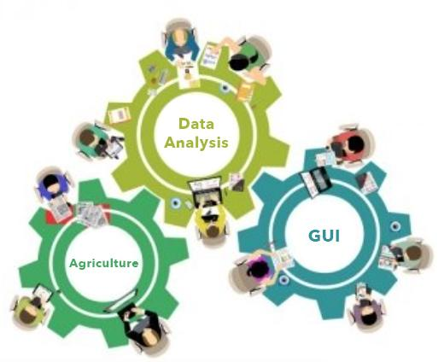
Smart Monitoring System
For Beekeeping
Farms

Slide 2

Team Members:
Guide: Dr. Ashwin M
Rahul Sanjay Mandviya - 19MIM10062
Abhinav Gadgil - 19MIM10067
Yash Sharma - 19MIM10068
Shivam Bajpeyi - 19MIM10082

Slide 3
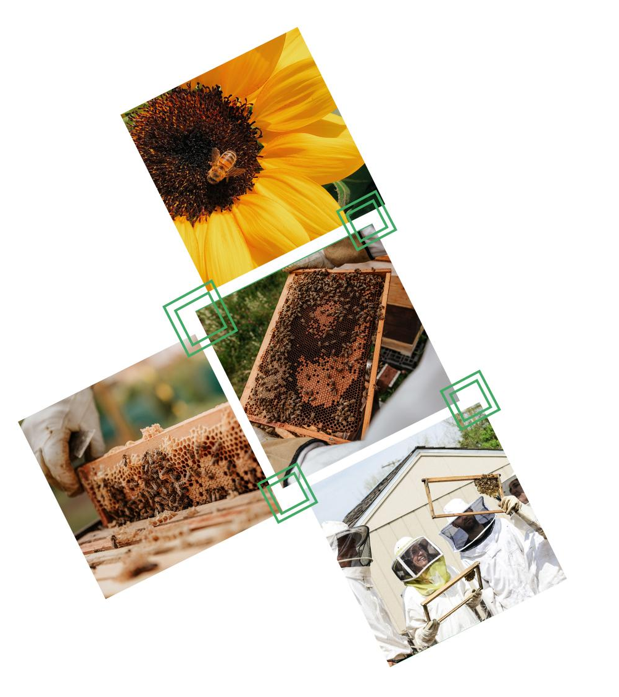
INTRODUCTION
Beekeeping (or apiculture) is the maintenance of bee colonies, commonly in man-made hives, by humans. Most such bees are honey bees in the genus Apis, but other honey-producing bees such as Melipona stingless bees are also kept.
A beekeeper (or apiarist) keeps bees in order to collect their honey and other products that the hive produce (including beeswax, propolis, flower pollen, bee pollen, and royal jelly), to pollinate crops, or to produce bees for sale to other beekeepers.
A location where bees are kept is called an apiary or "bee yard”

Slide 4
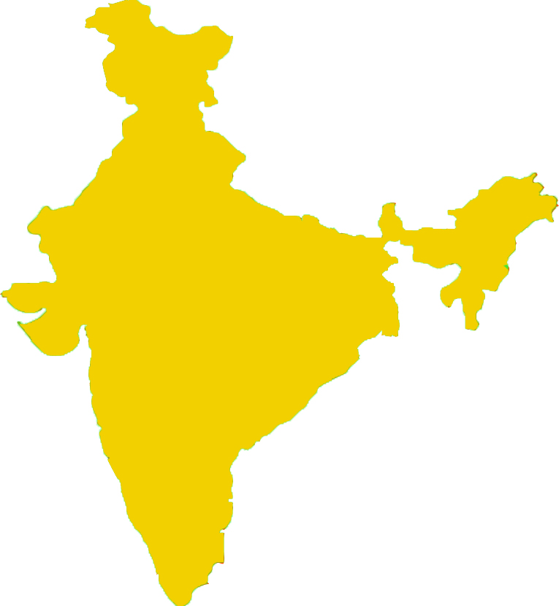
EXISTING WORK WITH LIMITATION
Continuous monitoring of honey bee hives has been the subject of considerable attention from beekeepers, apidologists and researchers for over a century.
Traditional beekeeping in India is practiced by local farmers based on their observational knowledge. Due to lack of technology, farmers are unable to identify the cause and effect of bee formations that lead to failure in maintaining their colonies.
According to Food and Agriculture Organization (FAO), Beekeeping employs 2,50,000 people living in 40,000 villages.
According to National Bee Board (NBB), Number of bee colonies in Punjab and Maharashtra are 2,71,135 and 7,967 till 2019.
Though in Maharashtra, weather conditions are suitable for beekeeping, they are undeveloped in comparison to Punjab which is one of the leading states that implements technology in agriculture.

Slide 5
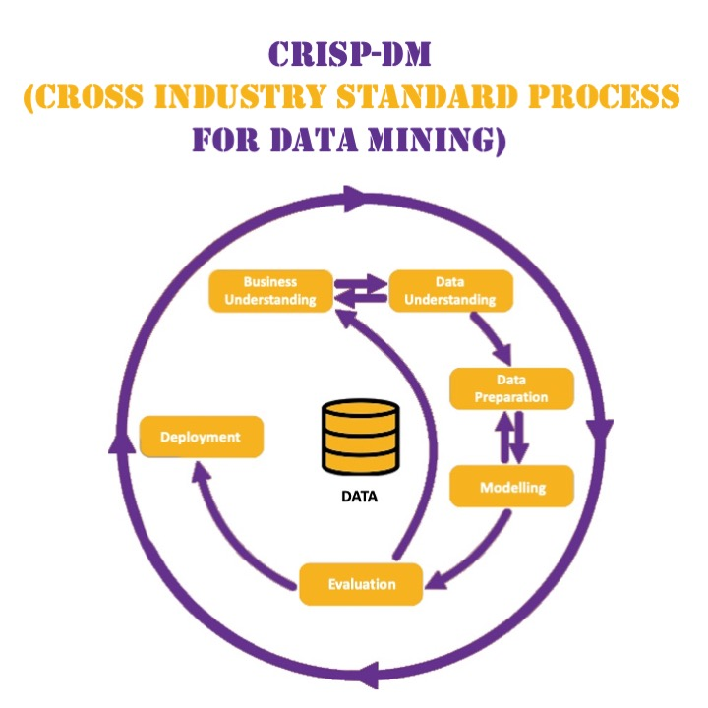
PROPOSED WORK AND METHODOLOGY
Do data preparation for the factors involved in beekeeping.
Analyse the data and bring some meaningful insights using exploratory data analysis.
Build an easy, ‘farmer centric’ GUI in order to help them understand the analysis and help them implement tasks according to requirements.

Slide 6
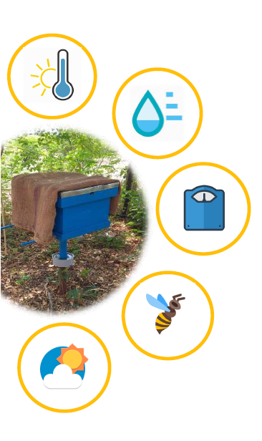
NOVELTY OF THE PROJECT
An innovative solution in beekeeping developed by a combination of IoT, data analysis, and app development.
Help for beekeeping farmers through robust decision making.
Simple, easy to use, farmer-centric mobile application to represent real-time data analysis in simple graphical format.
Increases the yield of the products of a beehive.

Slide 7
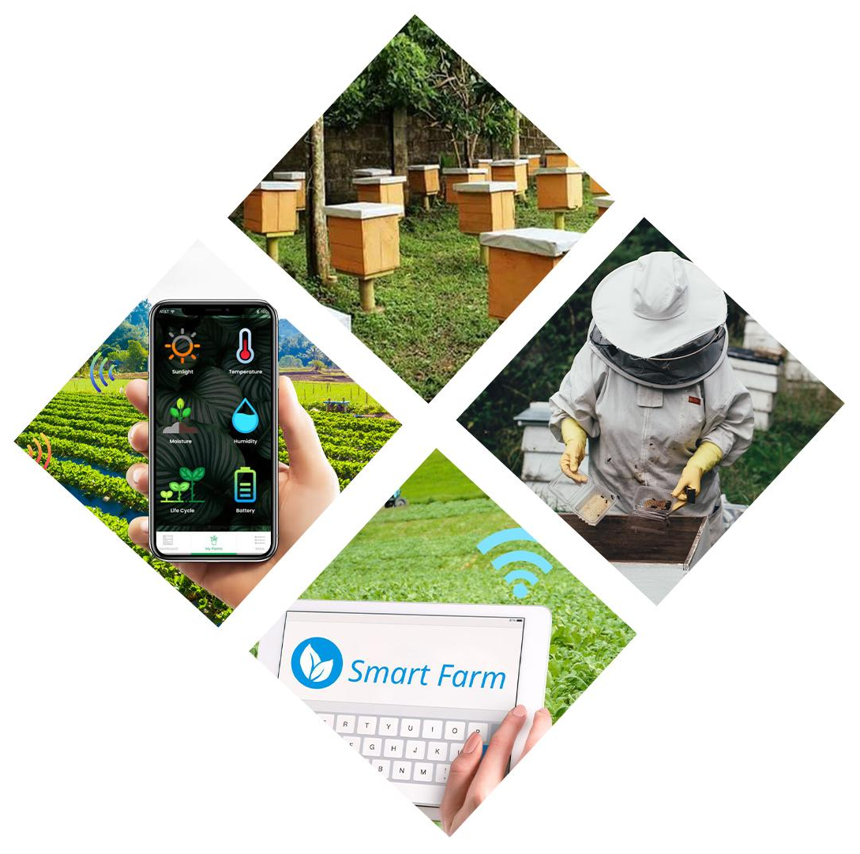
REAL TIME USAGE
In developing nations like India, traditional farmers put wet gunny bags to maintain desired temperature and humidity using their own intuition which may lead to low yield due to human errors.
Tracking the weight through analysis will help the farmer to know how frequently he has to open the beehive. This will help to reduce the disturbance caused to bees.
Temperature and Humidity inside the beehives play very important role in the
process of getting best yield. Hence, analysing
it will help in making better decisions
Mobile App will have pictorial and graphical information of analysis which will help farmer to know when to go and put wet gunny bag on the beehive. This will lead to a robust decision making thereby reducing human errors

Slide 8
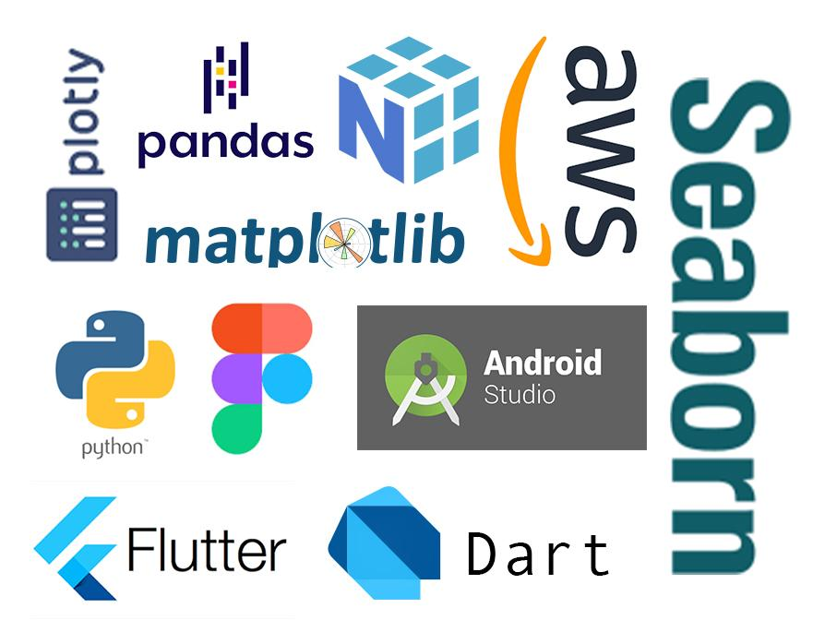
TECHNOLOGY USED
Figma (for WireFrame)
Datasets (for Analysis and Visualization)
Flutter Framework
Android Virtual Device (Android Studio)
Amazon Web Services (Cloud)
Text Editor (VS Code)
Programming Languages used:
Dart for App Development
Python for Data Analysis
Python Libraries used: numpy, matplotlib, plotly, seaborn, pandas, datetime, etc.

Slide 9
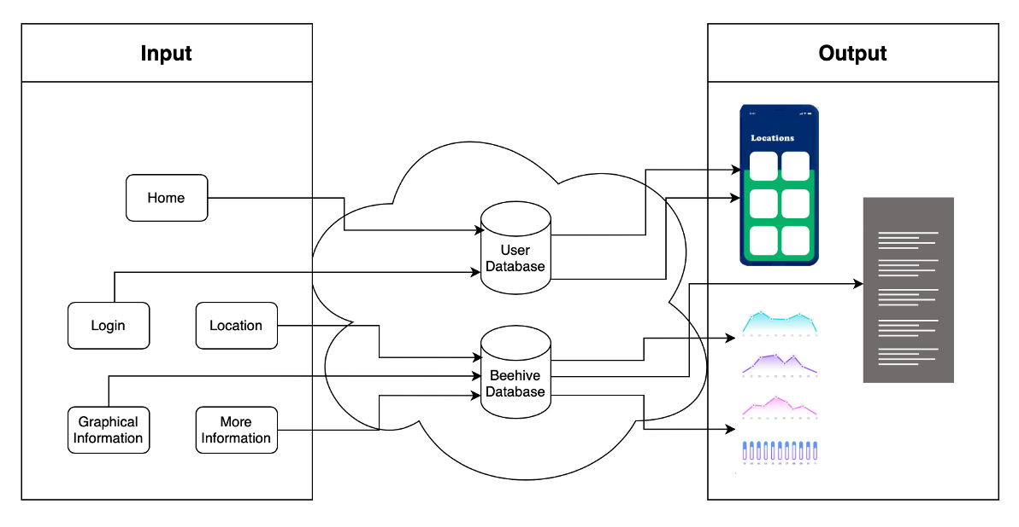
OVERALL SYSTEM ARCHITECTURE DIAGRAM

Slide 10
LITERATURE REVIEW
Yield from beehive could be halved if temperature exceeds the limit.
Bees are busy fanning the hive to cool it, rather than collecting pollen.
If the honeycomb melts, then some amount of honey is lost.
It is a combined effect of temperature and humidity that creates a non-conducive stressful situation for the bees.
Farmers use their own intuition for putting wet gunny bags on beehives.
Bee population ratio influences the yield.
Lifting the boxes to check weight or removing the lid disturbs the bees.

Slide 11
MODULE DESCRIPTION
Some analytics can be done on data collected from sensors in the beehive using python libraries like Pandas, NumPy, Matplotlib, Seaborn, etc.
A simple mobile app can be made using flutter for farmers wherein they can get real time update about
Temperature
Humidity
Weight

Slide 12
MODULE EXPLANATION
Analysis will help us to understand what temperature and humidity conditions are suitable for bees and how often the beehive needs to be emptied.
Through app farmer will be able to track the real time temperature and humidity of the beehive in a simple and easy to understand graphical format.
This will help them to make smart decision for putting wet gunny bag on the beehives.
Farmer will also get real time info about the weight of beehive and this will help him/her to know when to open beehive.
This will also reduce the time spent by bees in cooling the temperature of beehive and will keep them busy in the work of collection of nectar.

Slide 13
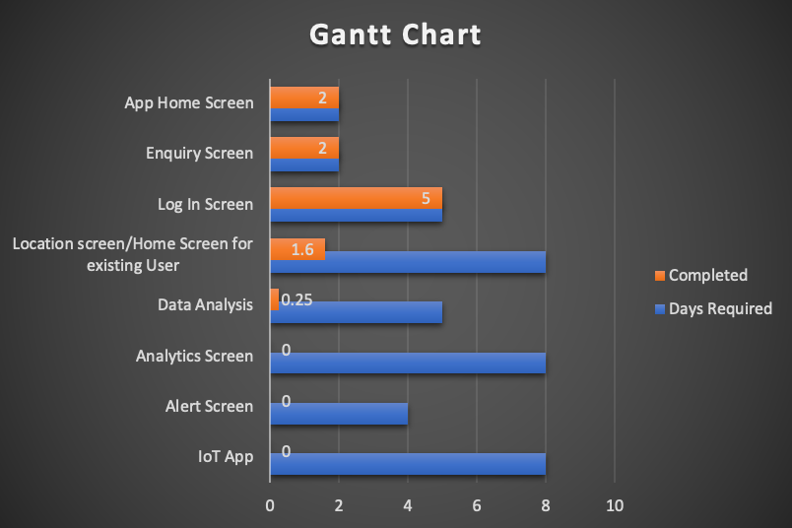
IMPLEMENTATION AND CODING

Slide 14
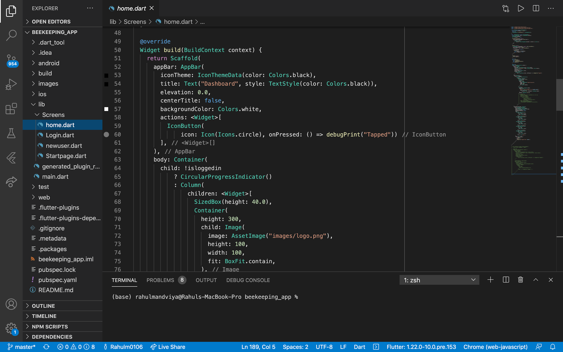

Slide 15
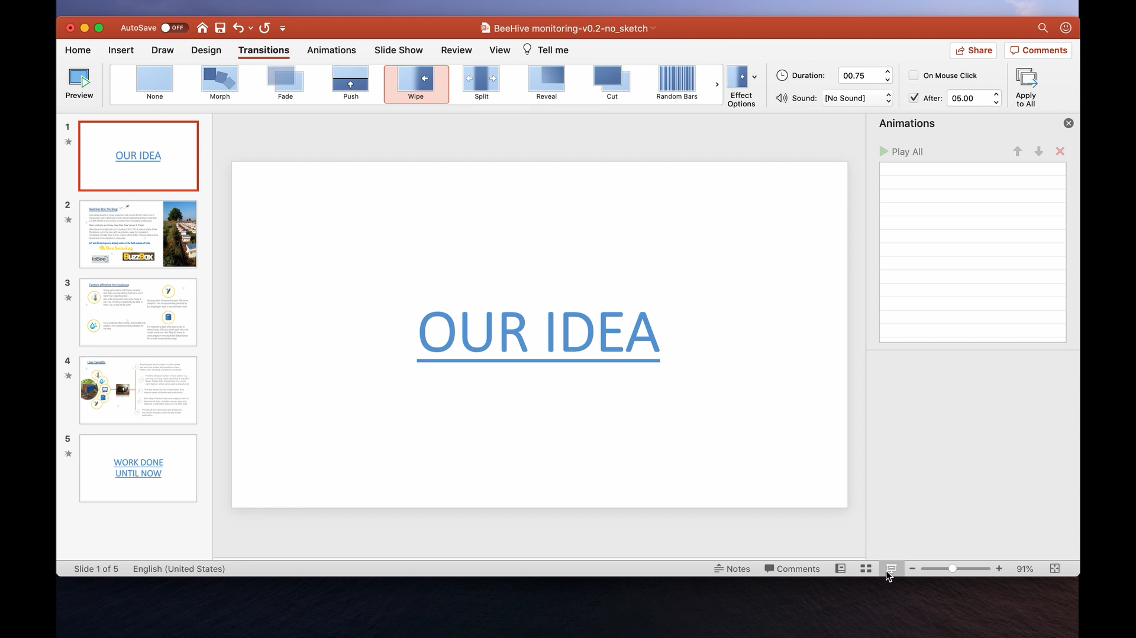
DEMO VIDEO

Slide 16
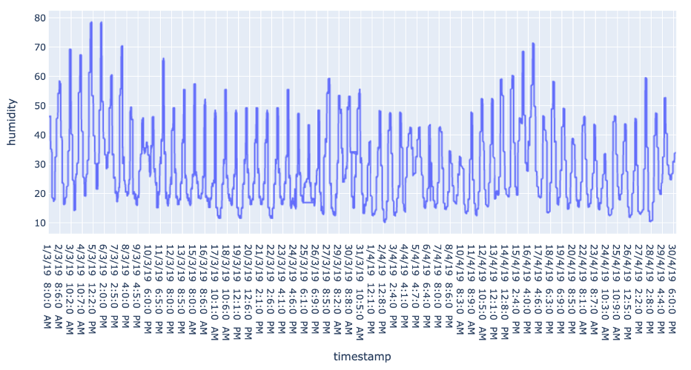
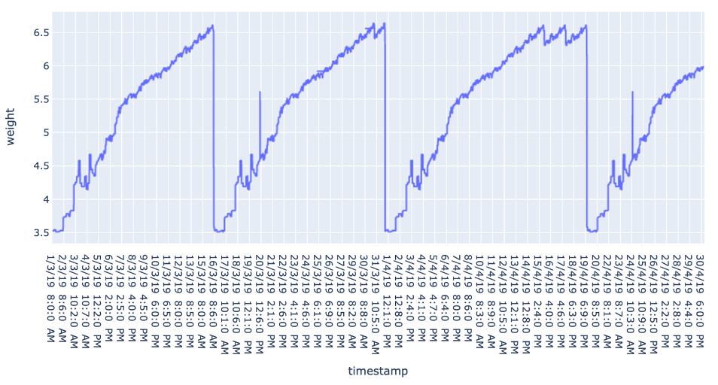
TESTING
Time series graph of humidity: To test the nature of humidity on daily basis. Basically we can infer the sequence and predict future values based on shape of graph. Here you can see for any date, maximum humidity does not exceed 80 % whereas minimum humidity does not fall below 10%
Time series graph of weight: To test the nature of weight on daily basis. Here we can infer that weight increases indefinitely in a span of 15 days before being emptied. This signifies that the weight of beehive lies between 3.5 and 5 kg on an average.

Slide 17
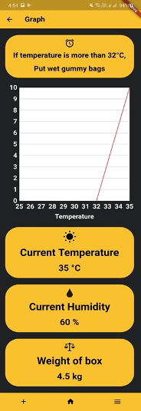
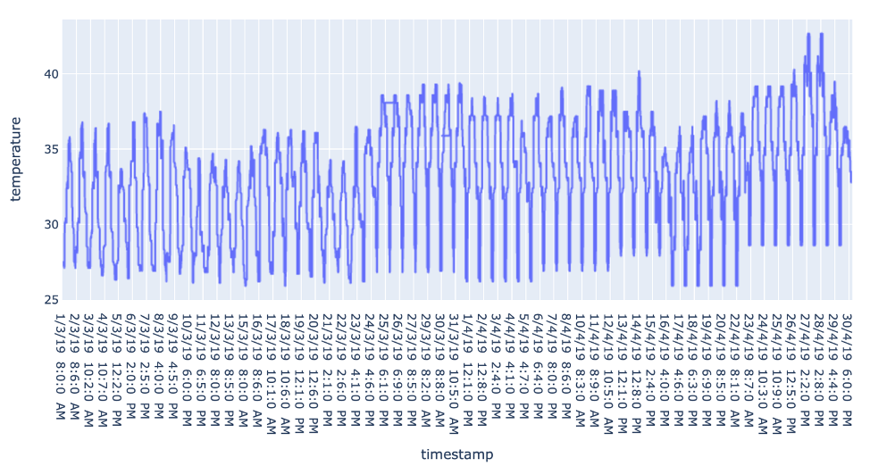
Time series graph of temperature: To test the nature of temperature on daily basis. As the data was collected in month of March and April, you can observe that there is a significant rise in temperature as we proceed from left to right. As there are no impossible values, we can proceed on our analysis.
To the left is the graph screen of our application which displays our observed temperature. It also displays other data variables and alerts the beekeepers if temperature crosses threshold value.

Slide 18
RESULT AND DISCUSSION
Based on our analysis we obtained the following results:
If the temperature crosses 32 °C, the bees start fanning in order to cool their hives. Above 40 °C the newer ones start melting affecting the entire colony.
Humidity should prevail between 40% and 60% for a strong colony nest. If the humidity exceeds 80% the fanning process even enables with better air circulation within the beehive. They restore their energy by removing droplets of water with their tongue.
In our application we added a extra field of location id so that if the beekeepers own more than one hive on same location then they can add another entry possessing same location name but different location id.

Slide 19
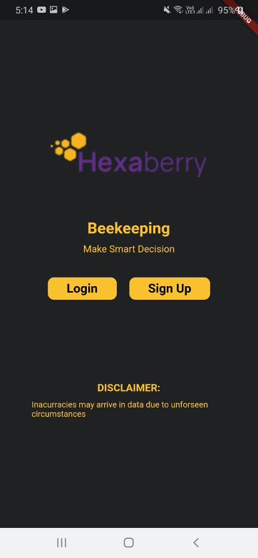
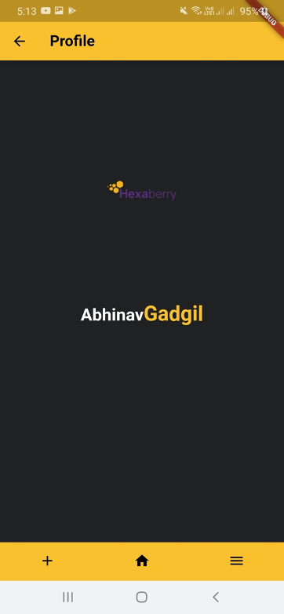
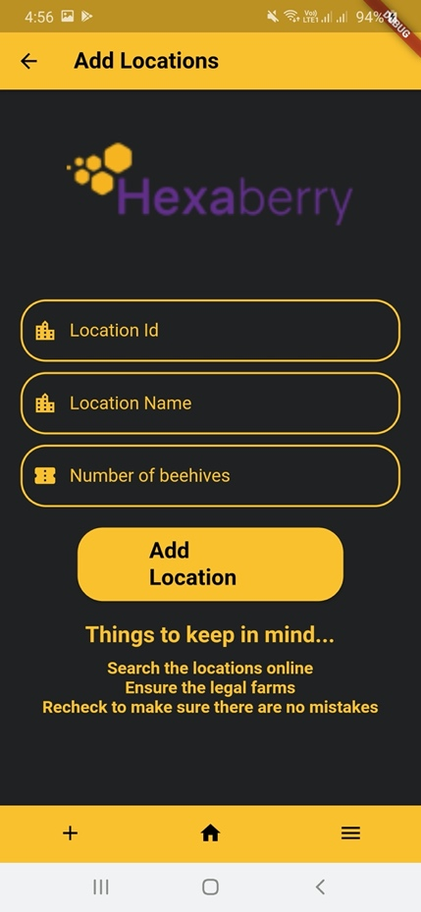
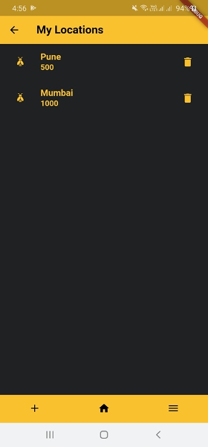

Slide 20
CONCLUSION
Inferentially, the project managed to give us hands-on experience with actual data and app development. After overviewing the observations, we can conclude that analysis of beekeeping is filled with intrinsic complexities that require tons of experience handling data.
Along with the three variables we analysed, we discovered that it is necessary to include other variables like rainfall, sunlight, soil intensity, vegetation intensity, bees sound frequency, location and topography of the region.
Last but not least, we learnt how honeybees are one of the most important organisms of our ecosystem while doing the literature survey.

Slide 21
SOURCES
http://agritech.tnau.ac.in/farm_enterprises/fe_api_harvestingandprocessing.html
https://en.wikipedia.org/wiki/Beekeeping
https://nbb.gov.in/pdf/Registered%20Beekeepers%202019.pdf
http://www.fao.org/home/en/

